Slide 1
Building a Science-Driven Mission Planning Tool with OSS JMARS
ISOW 2019 • May 3-4, 2019
Christian Schaller • schaller@lpl.arizona.edu
Lead Software Developer, Planetary Image Research Lab
Lunar and Planetary Lab
The University of Arizona
Tucson, Arizona, USA

Slide 2
Roadmap
Science-driven mission planning
JMARS
OSS JMARS
Example: Data supplier for existing shape layer
Example: Customized shape layer
Example: Mission planning layer
Java SPICE
Summary

Slide 3
Science-driven mission planning

Slide 4
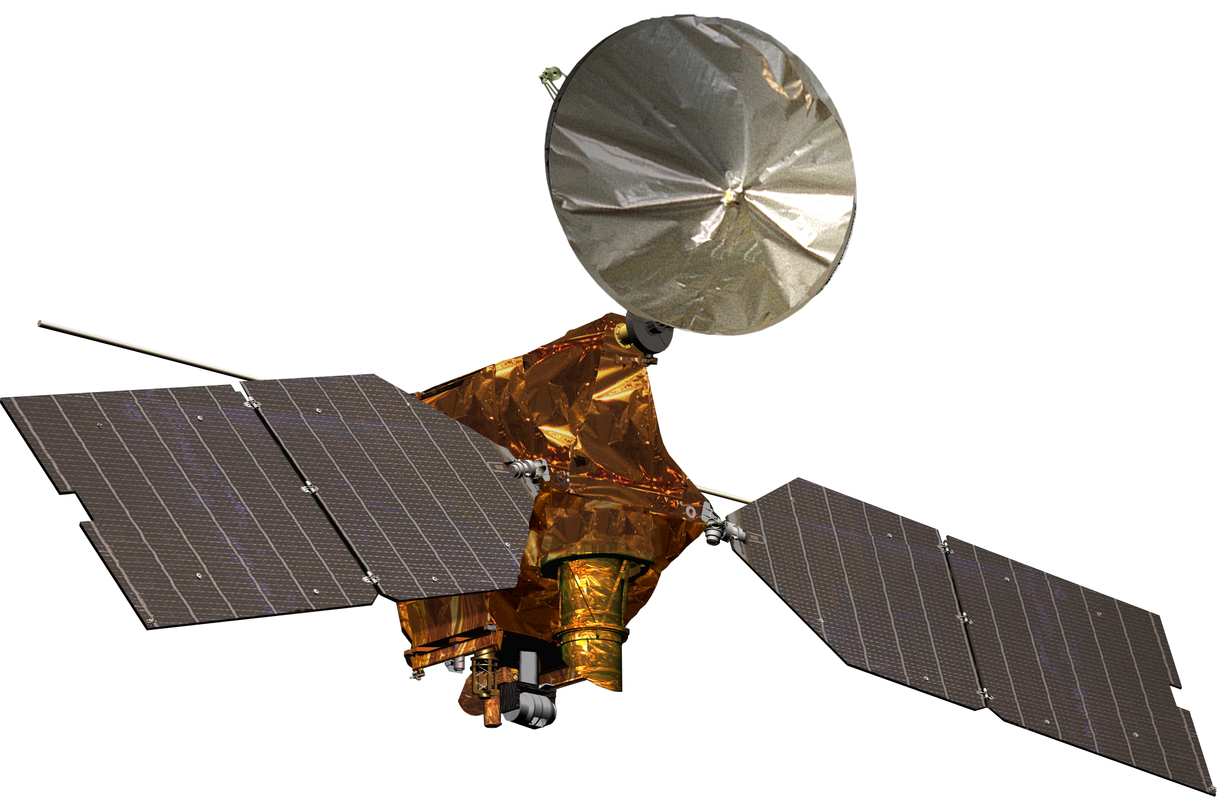
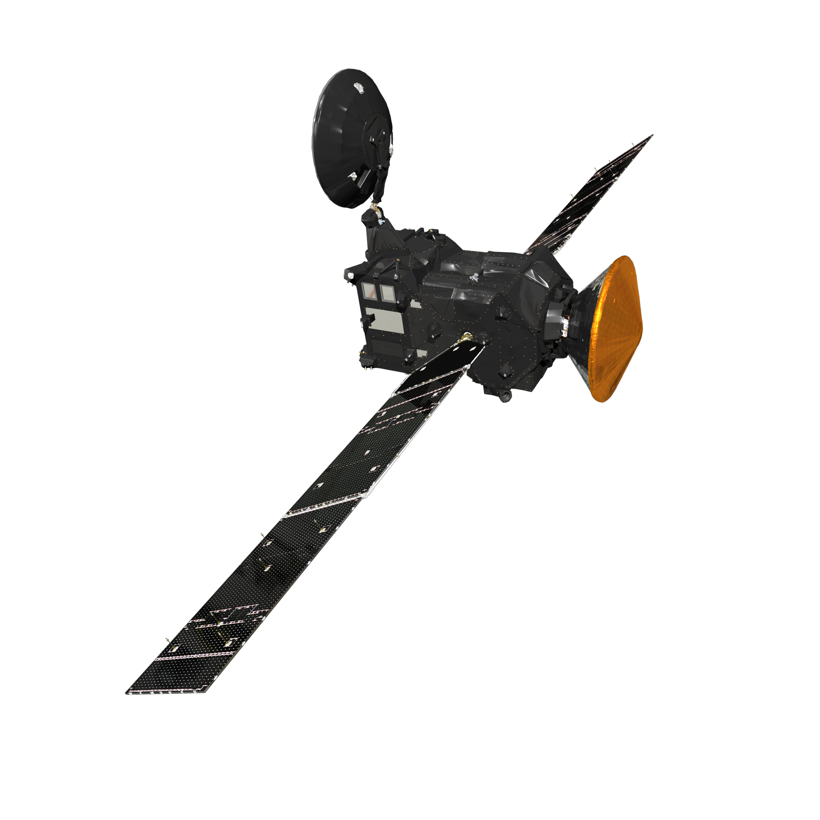
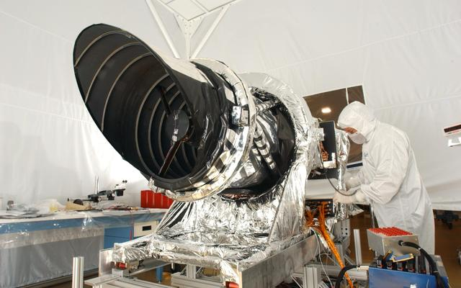
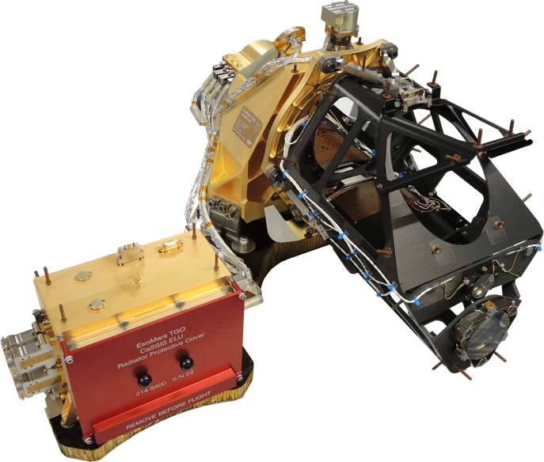
Mars Reconnaissance Orbiter & HiRISE (NASA)
Trace Gas Orbiter & CaSSIS (ESA, Roscosmos)
CaSSIS
HiRISE
ESA/ATG medialab
NASA
NASA/JPL/Ball Aerospace
Uni. Bern
Scan | Push-broom
Detector | 14 CCDs (2, 10, 2 config)
Detector Size | 2048 x 128, 14 bit/px
Ground Scale | 30 cm/px
Swath Width | 6 km
Colors | 3 (red, blue-green, nir)
Scan | Push-frame
Detector | 1 CMOS
Detector Size | 2048 x 256 strips, 14 bit/px
Ground Scale | 4.6 m/px
Swath Width | 9.4 km
Colors | 4 (pan, red, blue-green, nir)

Slide 5
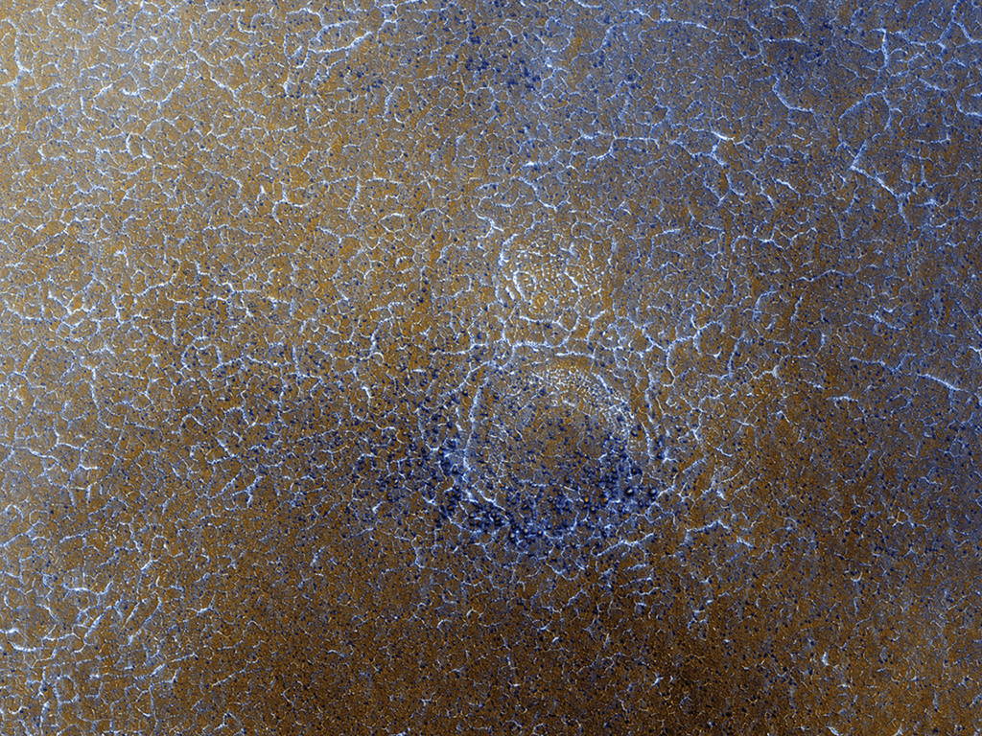
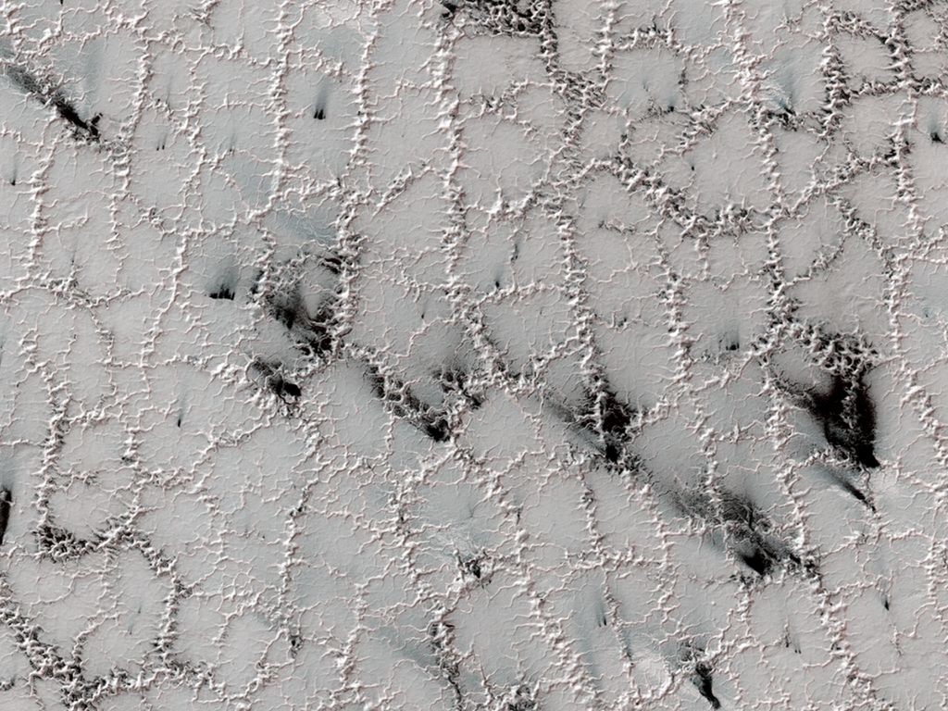
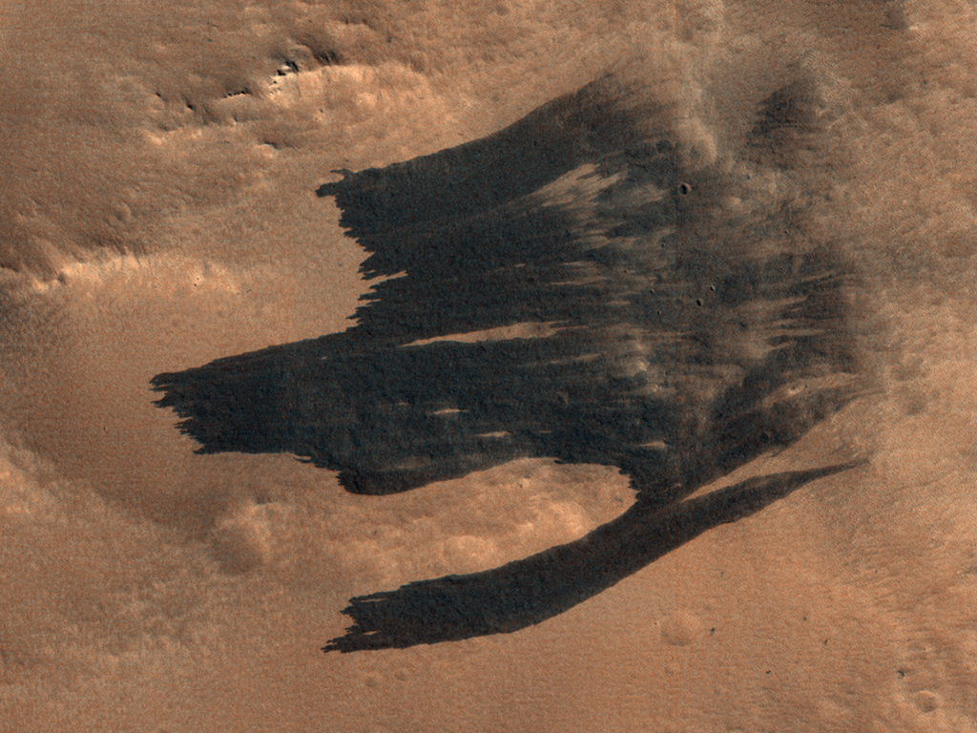
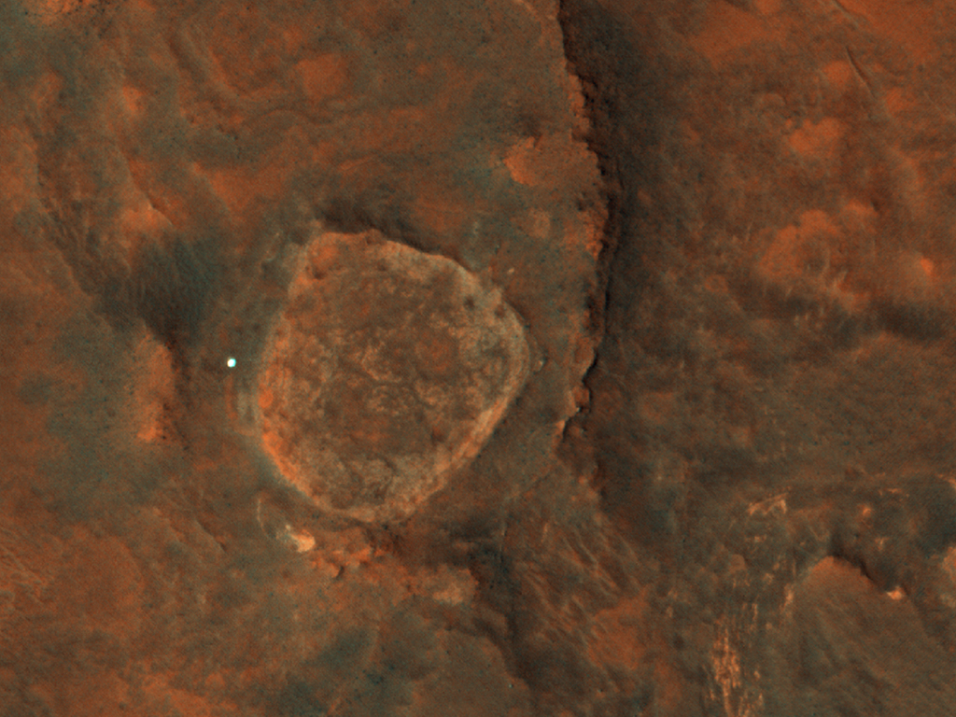
Is it safe to land here?
What’s going on here?!?
PSP_007448_2475 • NASA/JPL/University of Arizona
ESP_013049_0950 • NASA/JPL/University of Arizona
MER-A “Spirit”
How did these streaks form?
What’s the best route for this rover?
ESP_058514_2140 • NASA/JPL/University of Arizona
ESP_021925_1650 • NASA/JPL/University of Arizona

Slide 6
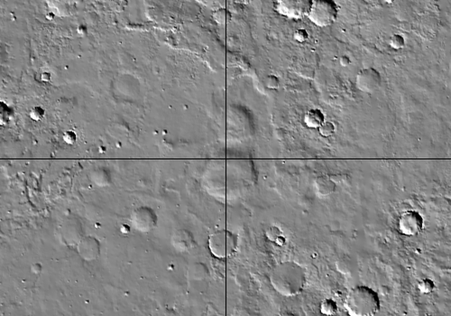
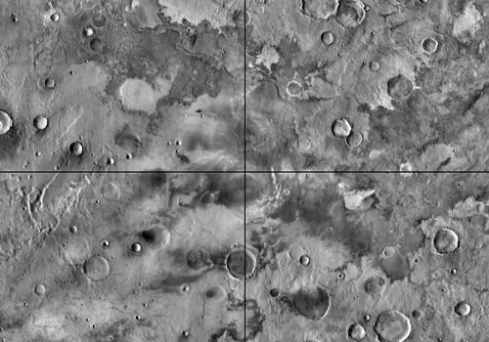
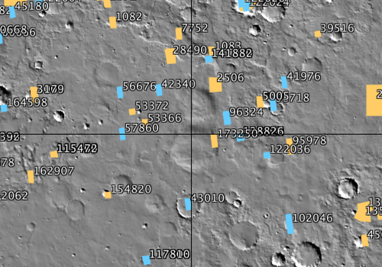
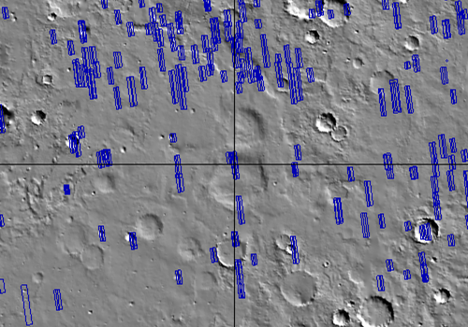
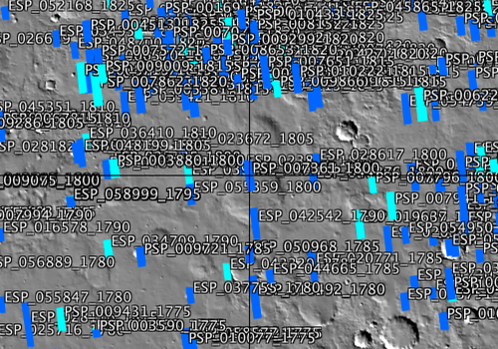
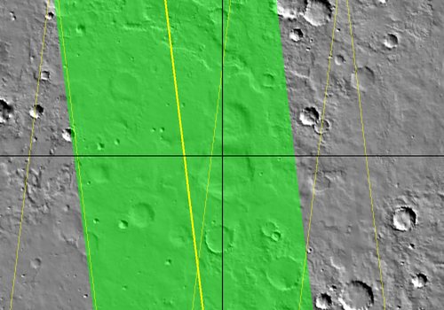
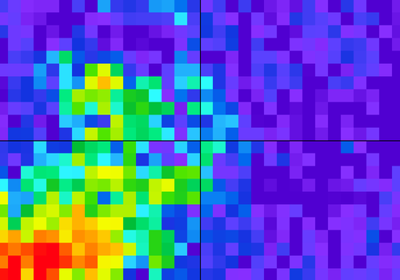
To answer questions like these, you might need…
Elevation/topography data (e.g., MOLA)
Albedo data (TES)
Thermal data (THEMIS)
Minerology maps (TES again)
Orbit tracks
Previously acquired images
Region-of-interest outlines
Location of existing hardware
Planned traverse paths
…all displayed in one view
…a geographic information system (GIS) application

Slide 7
JMARS

Slide 8
JMARS: A Java-based multi-body GIS app
Developed at ASU (in Phoenix, AZ – definitely not to be confused with UA in Tucson, AZ)
Originally for Mars, but now supports most large, rocky bodies in the Solar System plus a few asteroids
Data layers
Dozens of global base maps from various instruments
Image stamp layers
Ground track layers
Nomenclature
General shape layer
Crater counting layer
…each with customizable layer transparency
Used by MRO, OSIRIS-REx, TGO/CaSSIS…
https://jmars.asu.edu

Slide 9
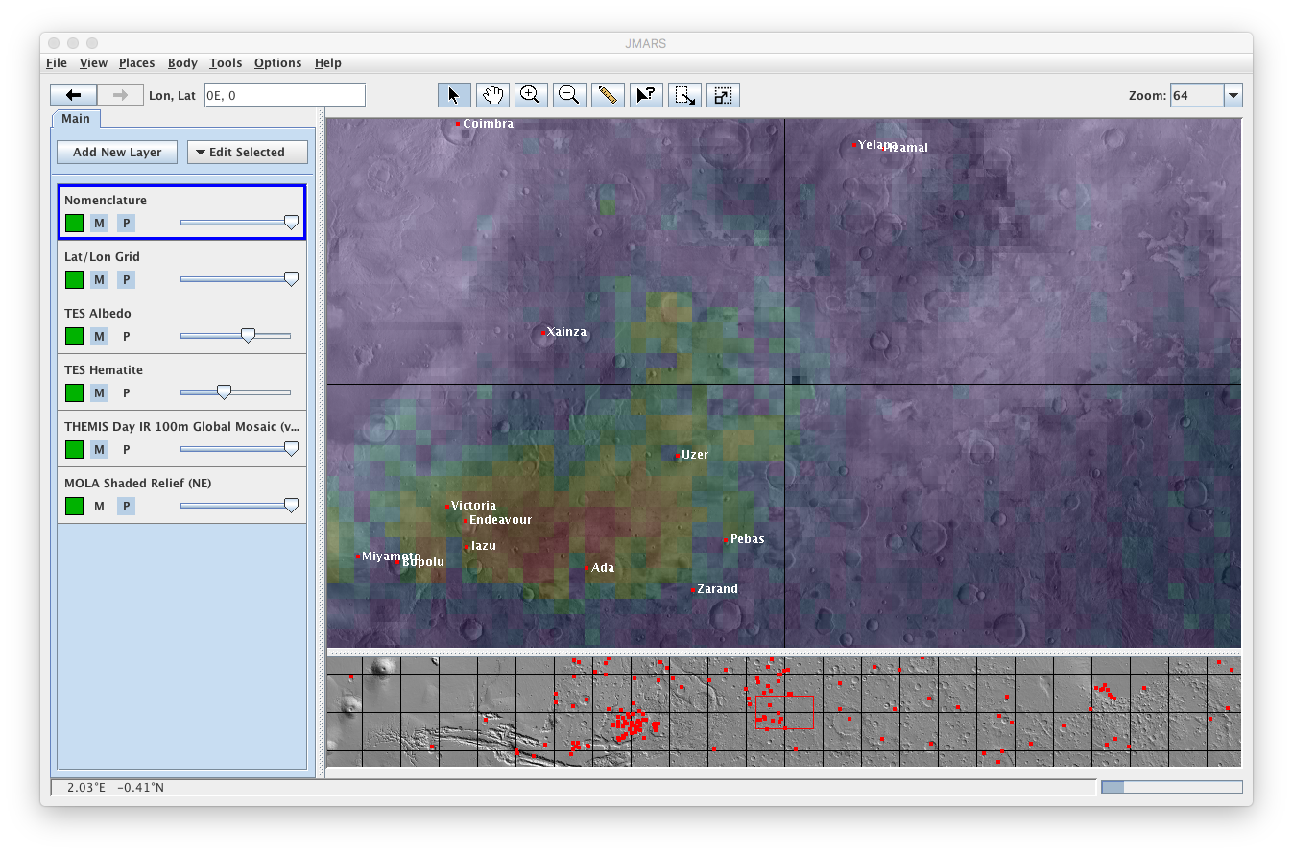
The public version of JMARS

Slide 10
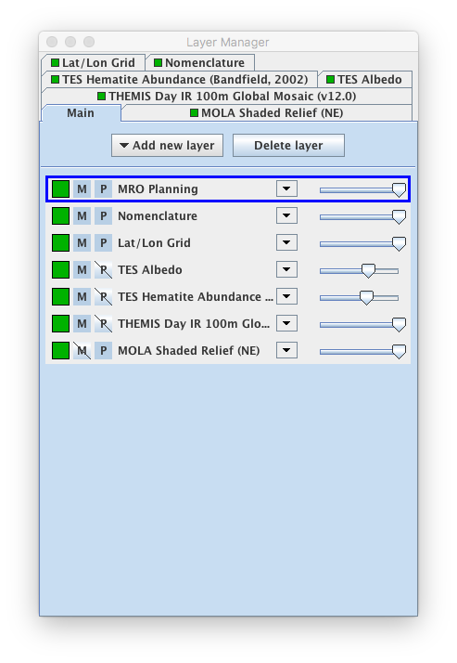
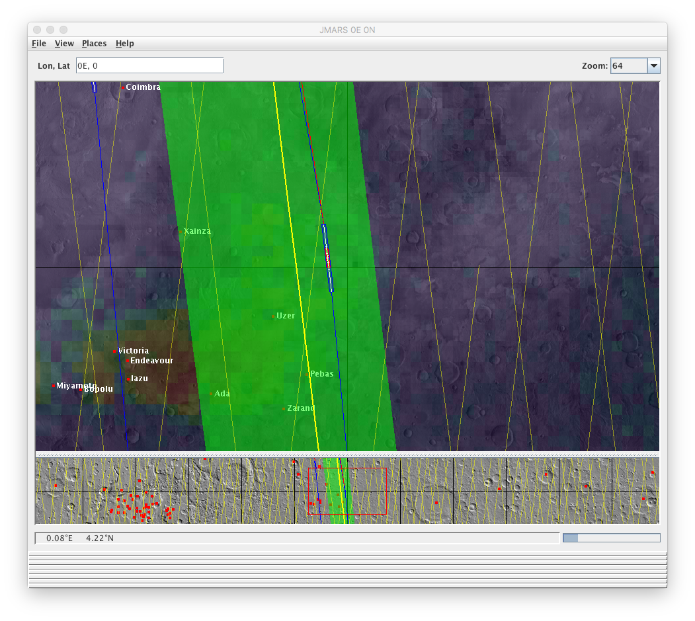
JMARS for MRO (Mars Target Tool, MTT) – HiPlan for HiRISE – Commissioned

Slide 11
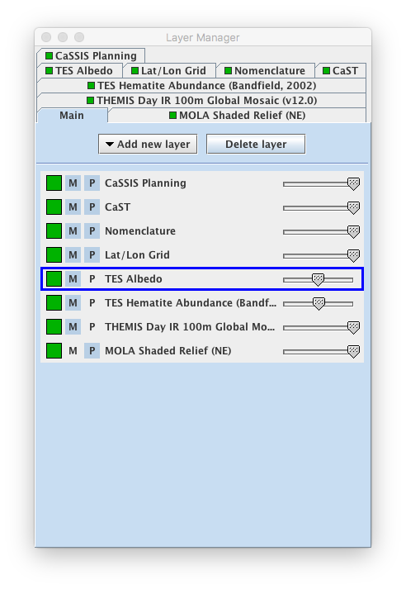
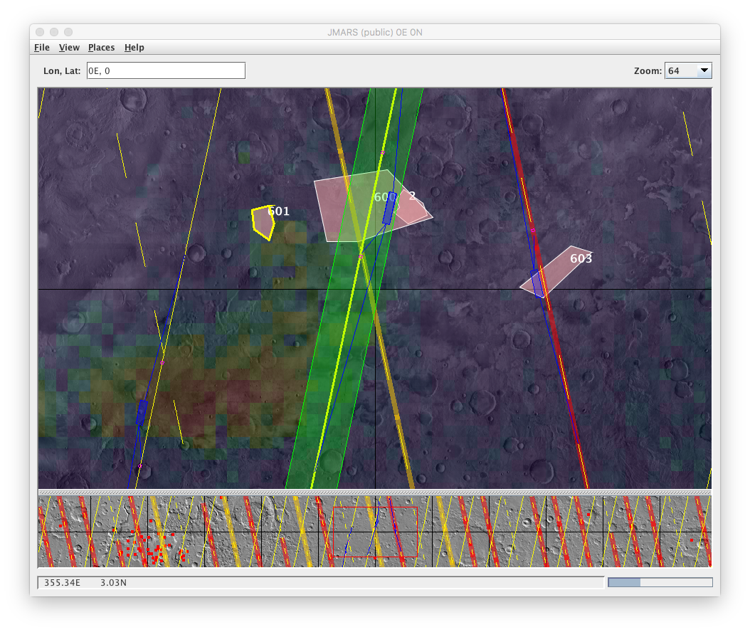
OSS JMARS for CaSSIS: PLAN-C

Slide 12
OSS JMARS

Slide 13
Open-source (OSS) JMARS
ASU has an open-source version of JMARS
https://jmars.mars.asu.edu/open_source
Subversion repo: http://oss.mars.asu.edu/svn/jmars/
Includes all the core capability of the public JMARS
Robust set of APIs
API documentation a little sparse
Underlying layer base classes feature
Multiple off-screen graphics buffers
MVC model
Threaded execution
Several example layers for use as starting points
Current version (r31) similar to current public version
PLAN-C actually built on r3, which looks more like MTT/HiPlan
Will transition PLAN-C to current OSS JMARS “one of these days”

Slide 14
Example: Data supplier for existing shape layer
Easy!

Slide 15
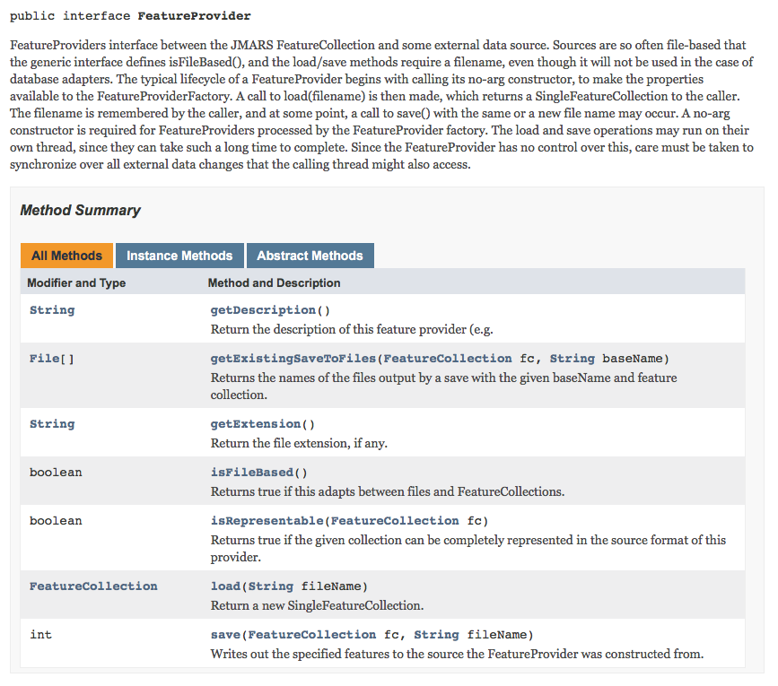
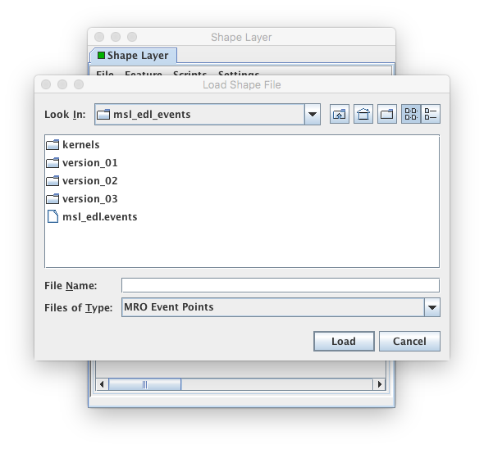
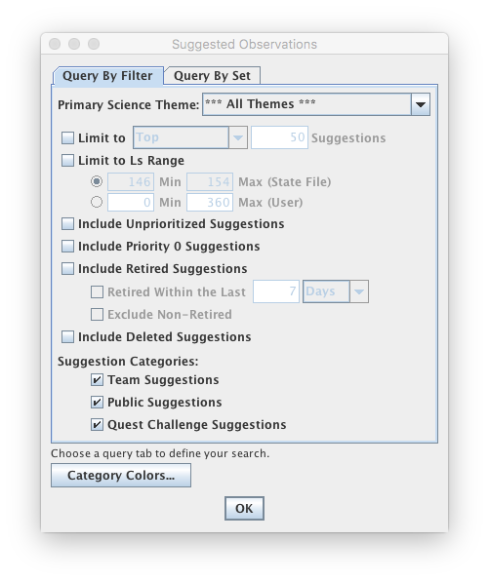
The shape layer’s primary data sources are defined by a very simple API
TRUE
FALSE

Slide 16
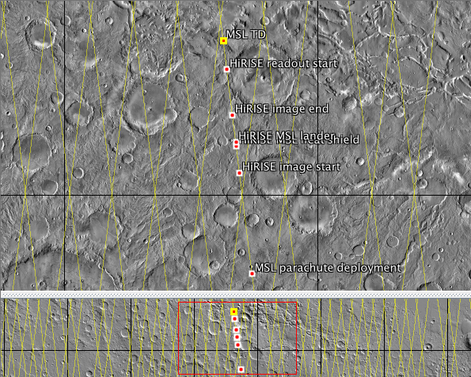
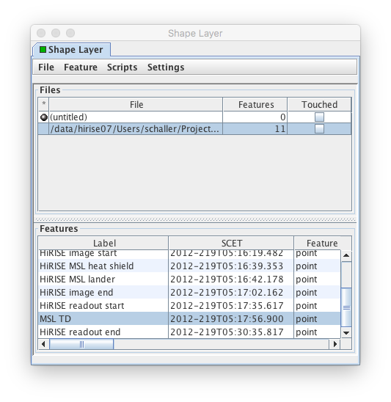
Spacecraft event points file source
TRUE
#Event,Time
MSL Entry,2012-219T05:10:46.000
HiRISE CPMM power,2012-219T05:11:10.480
MSL guidance start,2012-219T05:11:31.900
MSL parachute deployment,2012-219T05:15:05.100
HiRISE image start,2012-219T05:16:19.482
HiRISE MSL heat shield,2012-219T05:16:39.353
HiRISE MSL lander,2012-219T05:16:42.178
HiRISE image end,2012-219T05:17:02.162
HiRISE readout start,2012-219T05:17:35.617
MSL TD,2012-219T05:17:56.900
HiRISE readout end,2012-219T05:30:35.817
Caveat: SPICE required to turn times into coordinates!

Slide 17
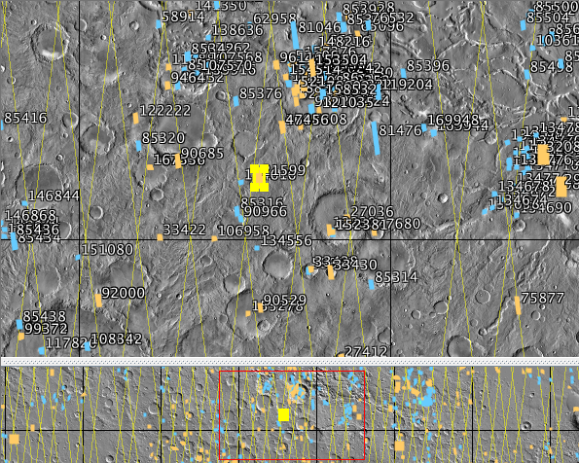
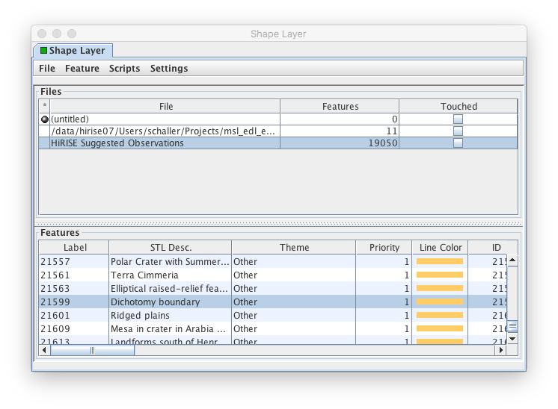
HiRISE target database non-file source
FALSE

Slide 18
Example: Customized shape layer
(This layer is the work of Guy McArthur, Data Applications Developer, PIRL/LPL/UA!)
A Little Trickier!

Slide 19
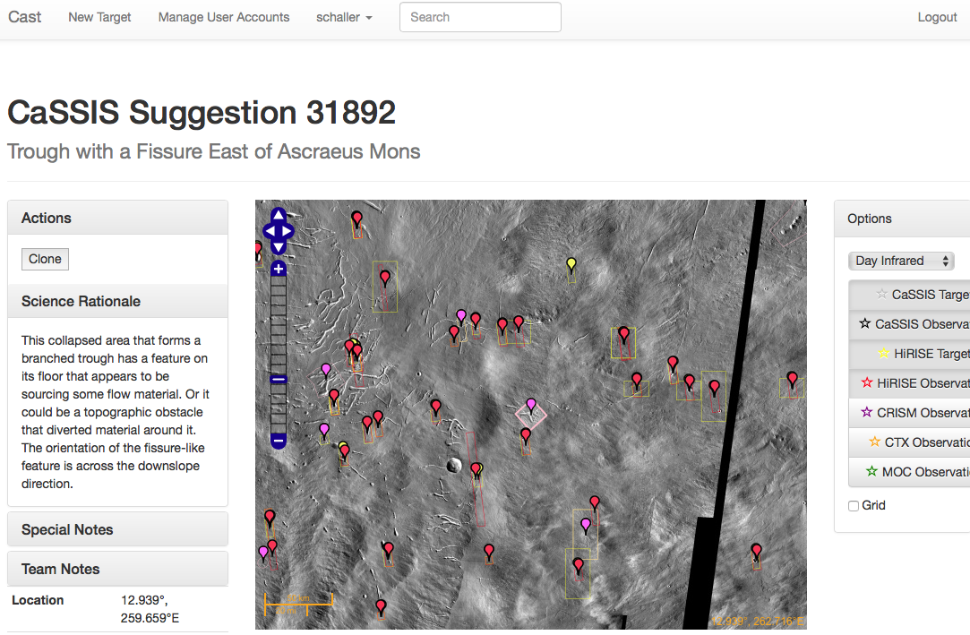
CaST web app: CaSSIS Suggested Targets

Slide 20
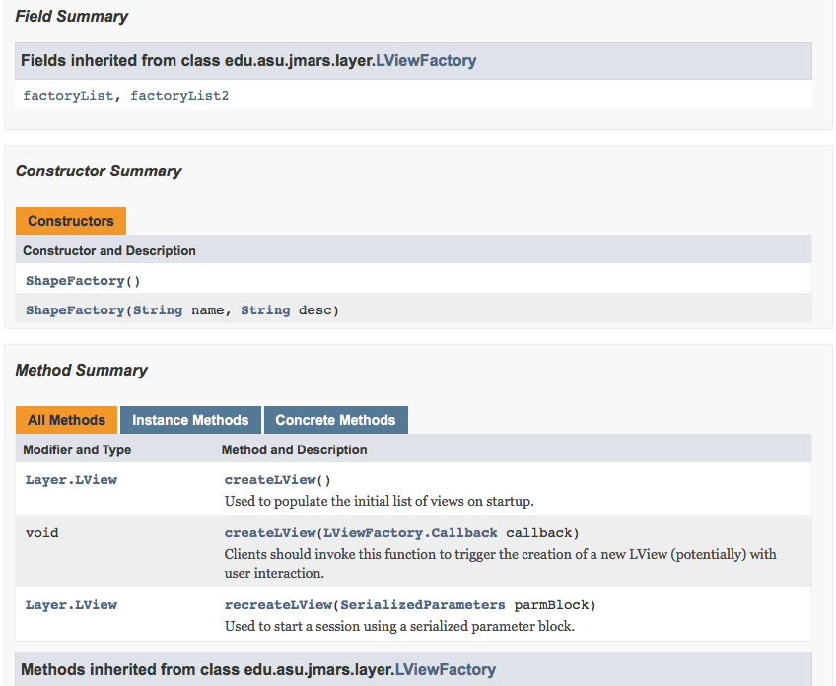
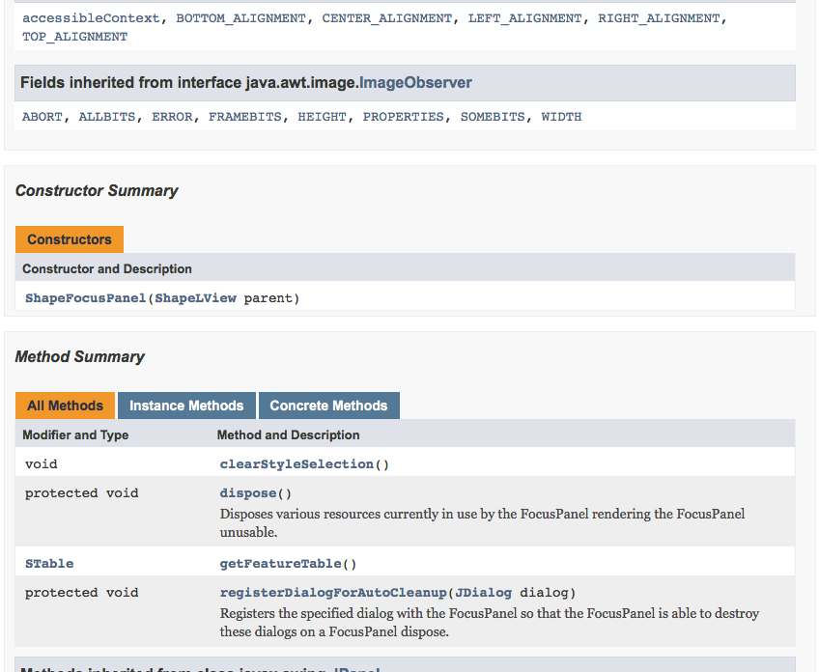
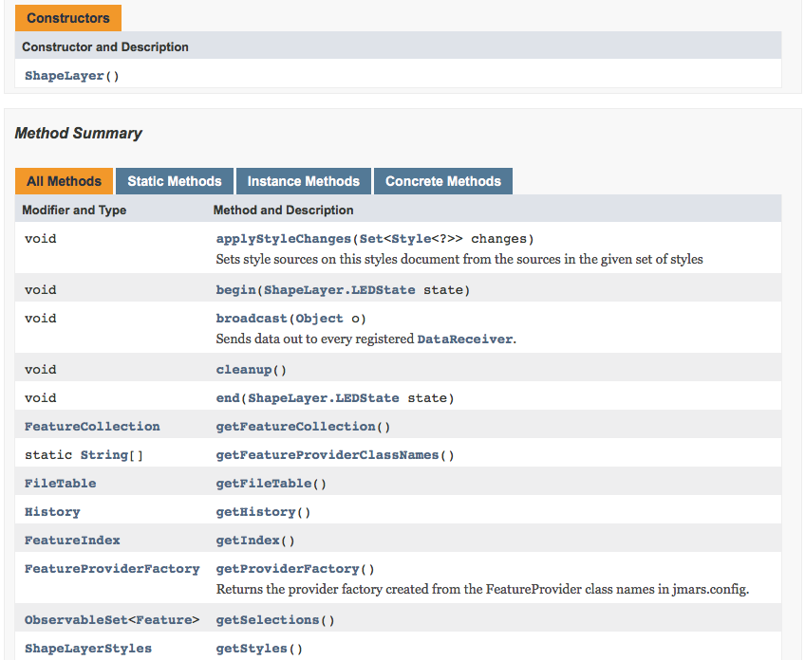
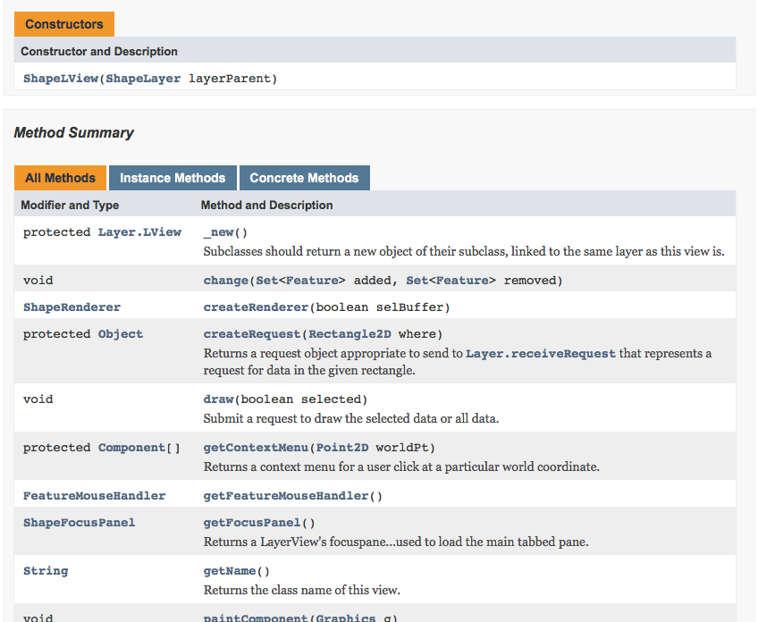
Customizing the shape layer requires a bit more work…
Four base classes to extend
…plus your own data classes
Some functionality not directly available
Needed to use Java reflection to get to some functions
Always a little risky
You DO get the nice MVC and thread management of the JMARS layer model, though!

Slide 21
Why not use a custom data source?
We needed much more control over this layer
Cannot be editable
CaST web app is the one and only source of targets
Can’t give PLAN-C user the impression they can edit in PLAN-C!
Need a combination of file and database sources
Drag-and-drop or copy/paste a list of targets
Directly search the target database
Need to display a more complex table
Target database includes sites plus series variants!
E.g., a target for stereo has two variants, forward and reverse look
A seasonal target may have 2, 3, 4, 10, 20 or more variants

Slide 22
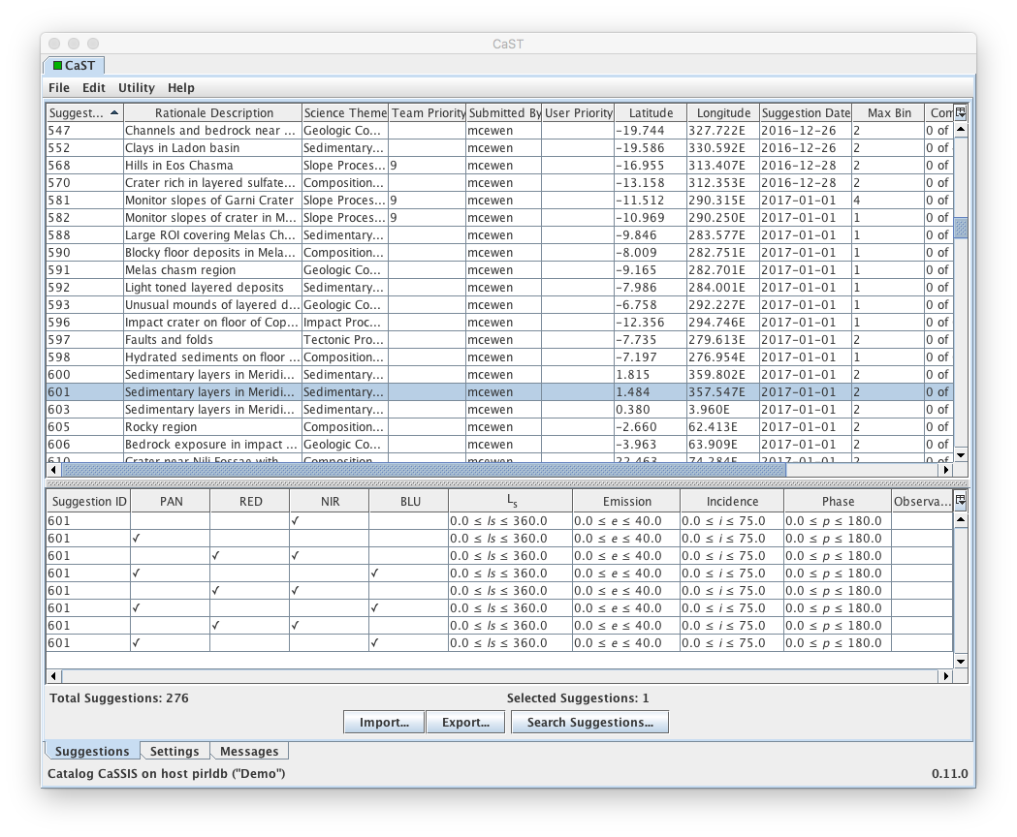
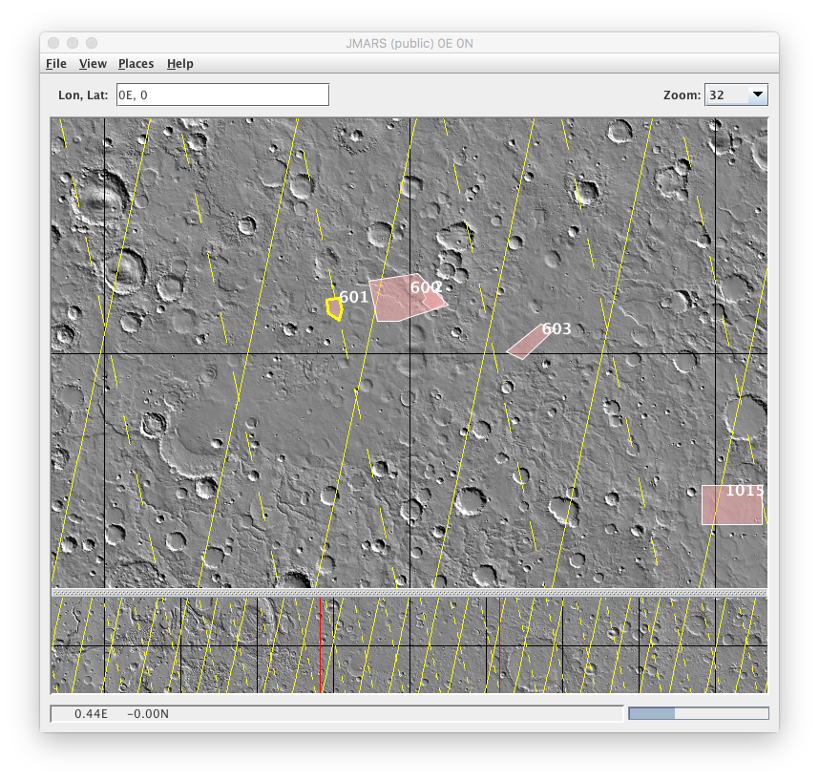
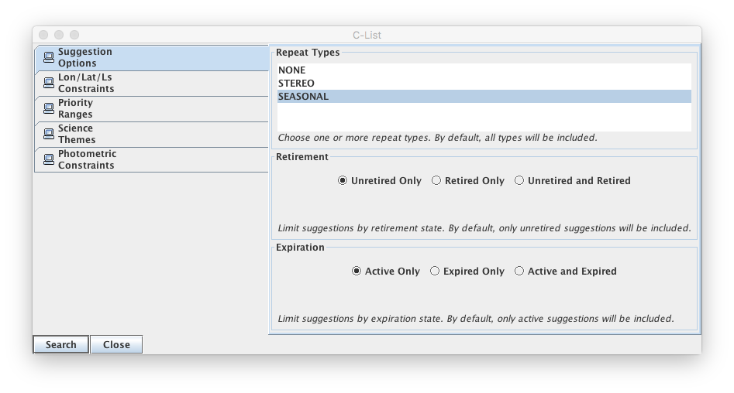
We gained a lot from the base class, but could customize it to our needs…relatively easily!

Slide 23
Example: Mission planning layer
Quite
Complicated!

Slide 24
Mission planning layer: complex, complicated
The mission planning layer will likely be the most complex and challenging part of this process
Requirements
Display orbit tracks, including off-nadir extent
Display planned observations’ footprints
Display exclusion zones
Import from file or database
Store plan in database, export to file for third-party use
Add/remove observations from the plan
Control camera settings
Model data volume use and data transfer rates
Check for flight/ops rule violations
Present timeline view of plan
No existing API for most of this!
Can use the built-in ground track layer as a starting point, though
No existing SPICE solution!

Slide 25
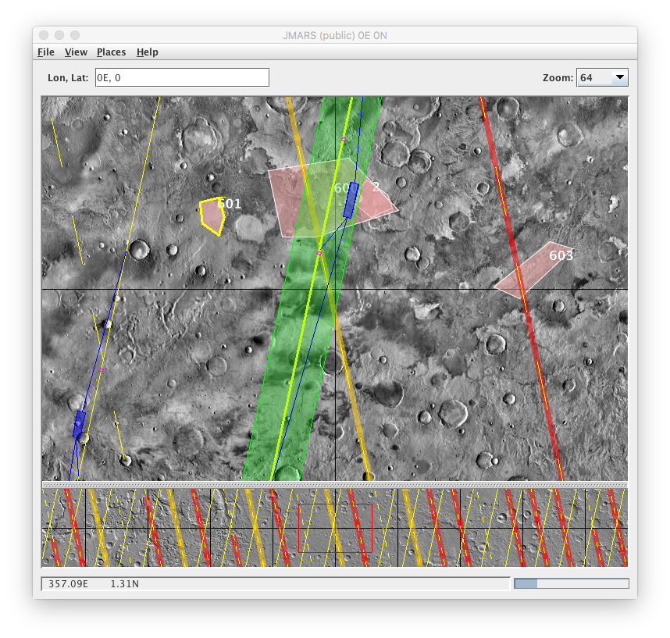
CaSSIS planning layer map features
Main view (JMARS core)
Solid yellow line: day, no exclusions
Blue box: CaSSIS image footprint
Tiny magenta box: TGO at image center
Pink box: CaST layer beneath
Green box: off-nadir extent of selected orbit
Orange highlight: no targeted, nadir warning
Red highlight: no imaging allowed
Dashed line: night
Panner view (JMARS core)

Slide 26
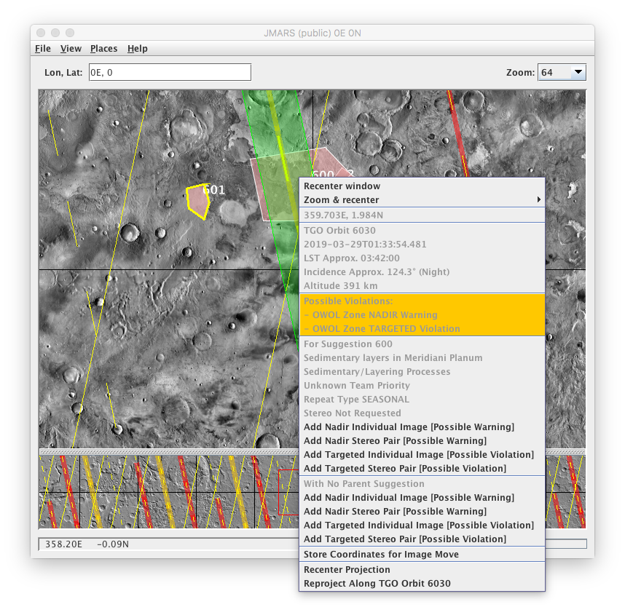
Adding an image to the plan
Adding here, inside outline of target 600, on a night segment inside an ”observation wheel off-load” zone
Coordinates
Time, lighting
Exclusion warning for nadir, violation for targeted
If parenting to target 600…
If not parenting to a target

Slide 27
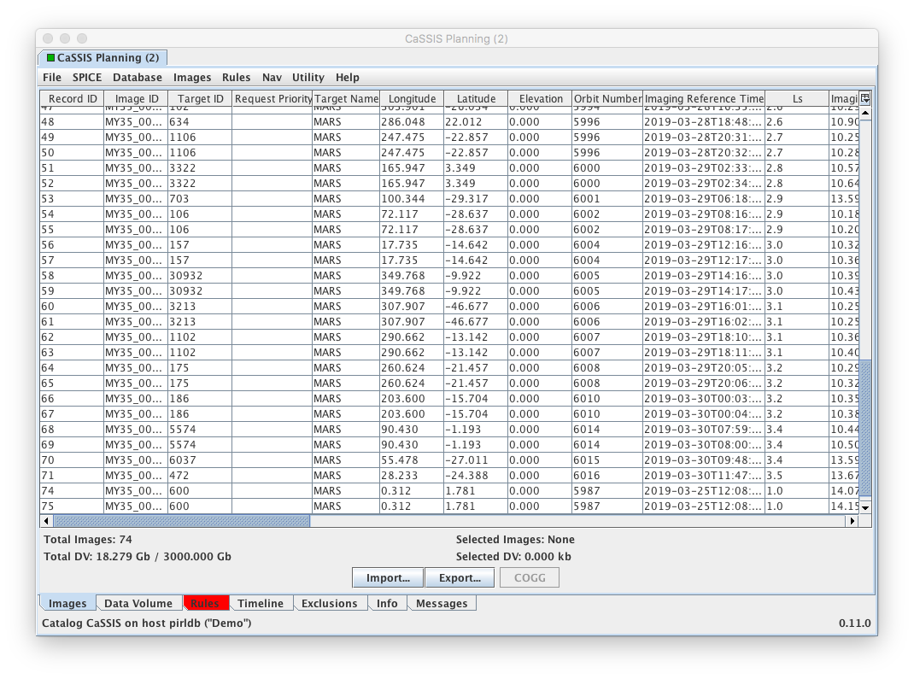
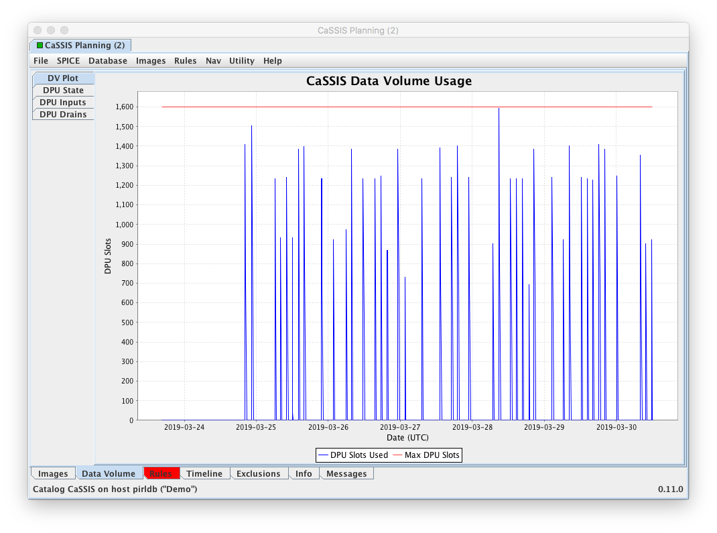
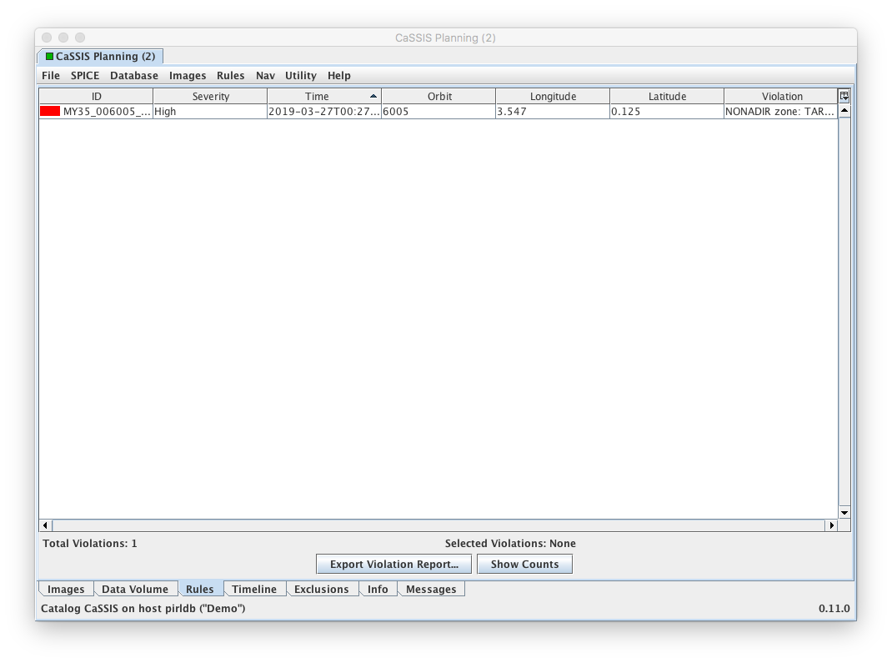
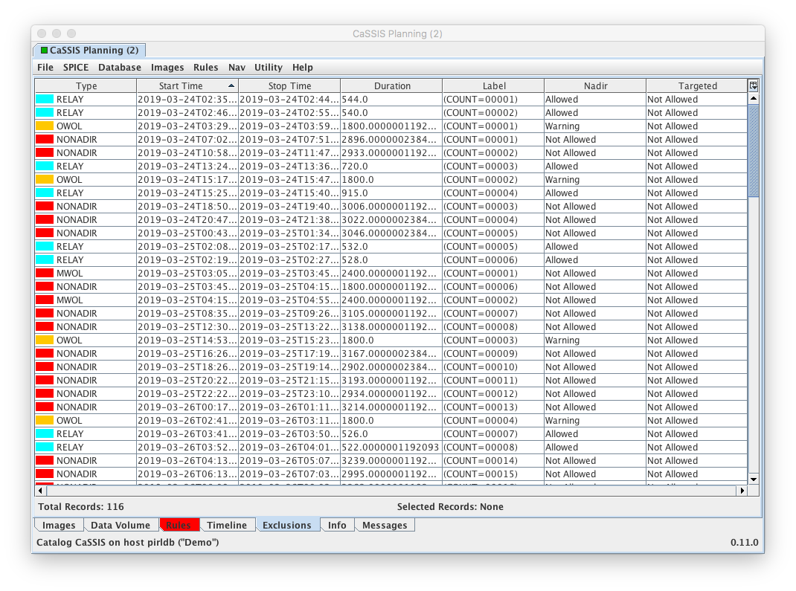

Slide 28
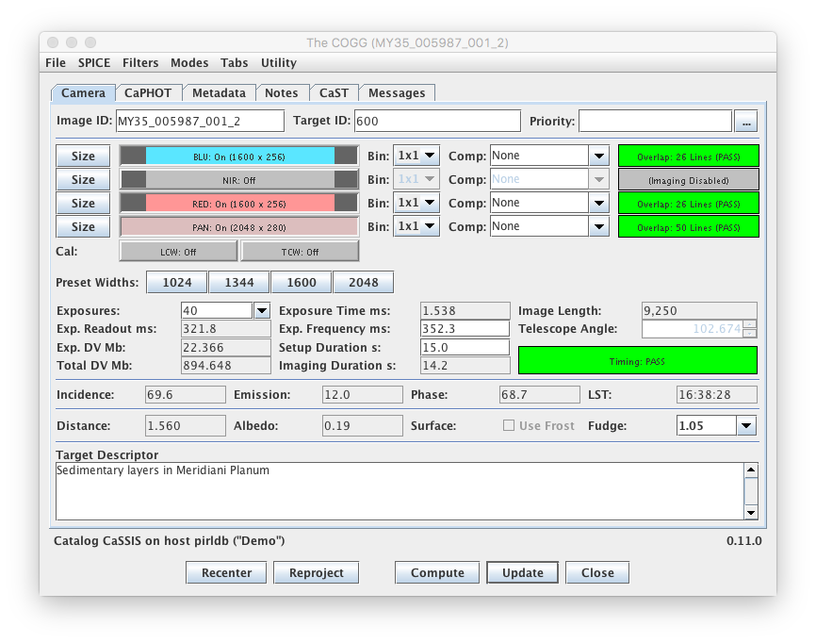
COGG: CaSSIS Observation Generation GUI (after HOGG: HiRISE…)

Slide 29
Java SPICE

Slide 30
SPICE in Java
NAIF SPICE toolkit used for spacecraft/body position, velocity, pointing, timing
https://naif.jpl.nasa.gov
Fortran, C, IDL, Matlab officially supported
When we started, there was no widely available Java toolkit
NAIF: JNISPICE, flagged as an “alpha-test”
ASU: JSPICE (used in MRO tools MTT, HiPlan), not released
Destined for public release, I believe
Obviously we rolled our own: UA-SPICE
Large effort, diverted some resources from PLAN-C proper
Useful in other contexts, useful learning experience
Likely open-source it
NAIF’s JNISPICE is now “considered of sufficient quality to be released to interested persons”
Strongly recommend pursuing NAIF’s solution
I’ll likely replace UA-SPICE in PLAN-C with JNISPICE in the future

Slide 31
Summary

Slide 32
Summary
JMARS is a capable, Java-based GIS application suitable for science-driven spacecraft mission operations
The open-source version (OSS) can be extended to your particular needs with varying degrees of effort
Custom data sources for the shape layer require the least effort
Customizing an existing layer requires more effort but is a viable solution in some cases
A fully functional mission planning layer with resource modeling, flight rules, etc., can tap into everything provided by the JMARS core, but may require considerable effort
Probably best to use NAIF’s own JNISPCE as a SPICE solution
HiRISE: https://hirise.lpl.arizona.edu | CaSSIS: http://cassis.unibe.ch
JMARS: https://jmars.asu.edu | NAIF/SPICE: https://naif.jpl.nasa.gov

Slide 33
HIGH RESOLUTION IMAGING SCIENCE EXPERIMENT
uahirise.org

